Slide 1


1994: HISP Launches
1 of 15
DHIS2 began with the Health Information Systems Programme, known as HISP. HISP is a global action research network initiated jointly in 1994 by the University of Oslo and the University of Western Cape in South Africa. Its continued mission is to empower users at local levels to use their data for evidence-based decision making.
Health Information Systems Programme
HISP
Prev
Next

Slide 2
1996: DHIS launches
2 of 15
DHIS
District Health Information Software
As a result of the HISP collaboration, the District Health Information Software, or DHIS, was launched in South Africa in 1996, eventually becoming their national Health Management Information System (HMIS) in 1999. DHIS - which later evolved into DHIS2 - was designed from its initial conception to facilitate local data use.
Prev
Next

Slide 3



2004: DHIS2 development begins
3 of 15
DHIS was designed as an offline system running on local databases. This resulted in challenges aggregating and sharing data and scaling up implementations over time. As a result, in 2004, development of the web-based version 2 of DHIS (DHIS2) began at the University of Oslo. As a web-based platform, DHIS2 offered significant increases in accessibility by allowing users to enter and access their data from anywhere with internet connectivity.
DHIS
Prev
Next

Slide 4
2006: DHIS2 launches
4 of 15
The first web-based DHIS2 implementation launched in 2006 in Kerala, India.
Kerala, India
Prev
Next

Slide 5
2010: DHIS2 implemented in Africa
5 of 15
2010 saw the first implementation of DHIS2 in Kenya. This was quickly followed by Ghana, Rwanda and Uganda. DHIS2 usage has continued to expand throughout Africa, supported by a network of local DHIS2 experts, who have helped build national and regional capacity for DHIS2 use and configuration. These efforts have made the region a center for local innovation with DHIS2.
Kenya
Uganda
Ghana
Rwanda
Prev
Next

Slide 6

2011: DHIS2 Academy launches
6 of 15
In 2011 the DHIS2 Academy launched. UiO, in collaboration with HISP groups, runs academies every year on a selection of key topics, including both in-person and online courses. The Academy program contributes to developing and sharing best practices in presenting various DHIS2 concepts, and courses are continually modified to meet the global community’s needs.
Prev
Next

Slide 7



2012: Joint international support for DHIS2
7 of 15
In 2012, the international development organizations the President's Emergency Plan for AIDS Relief (PEPFAR), the Global Fund, and the Norwegian Agency for Development Cooperation (NORAD) began a joint donor effort to fund DHIS2 to strengthen its use in countries. This support was instrumental in scaling up the deployment of DHIS2 across Africa and Asia.
Prev
Next

Slide 8

2014: DHIS2 Ebola response
8 of 15
2014 saw DHIS2 used in Liberia for the Ebola response. The initial individual-level data models deployed there have since been expanded upon in the Tracker application and are used for global case-based surveillance.
Liberia
DHIS2 Tracker
Prev
Next

Slide 9

2017: UiO becomes WHO Collaborating Centre
9 of 15
In 2017, UiO became an official World Health Organisation Collaborating Centre for Innovation and Implementation Research for health information systems strengthening. This collaboration led to the DHIS2 metadata concept, an innovative method of sharing best practice configuration and functionality.
Prev
Next

Slide 10

2015: DATIM launches
10 of 15
In 2015, DATIM, a PEPFAR-specific version of DHIS2, was launched. DATIM is now used by PEPFAR in more than 50 countries. DATIM continues to be one of the largest examples of a world-wide data warehouse within DHIS2; sharing standards and collating subnational data routinely across a large and varied geography.
Prev
Next

Slide 11



2018: Community of Practice
11 of 15
In 2018, the DHIS2 Community of Practice launched, providing an online discussion forum that replaced the earlier DHIS2 technical support mailing list, making it easier for DHIS2 practitioners to connect and share best practices and get support from around the globe.
Prev
Next

Slide 12
2019: DHIS2 for education
12 of 15
In 2019, DHIS2 was piloted as an Education Management Information System in the Gambia and Uganda. This configuration applies DHIS2’s built-in analytics tools and flexible data structure to the field of education and school management, while also facilitating data triangulation between health and education sectors, which can be useful in planning childhood vaccination campaigns, for example.
Education Management Information System
Prev
Next

Slide 13

2020: COVID-19 response
13 of 15
In 2020, COVID-19 metadata packages for DHIS2 were launched. This allowed countries to rapidly implement case-based surveillance, contact tracing and ports of entry programs to combat the coronavirus pandemic. The global DHIS2 response to COVID-19 also featured many examples of local innovation (configurations and apps designed by the HISP network and Ministries of Health) that were shared with the global community, including real time data entry at border crossings, and paperless lab testing and reporting processes.
Prev
Next

Slide 14
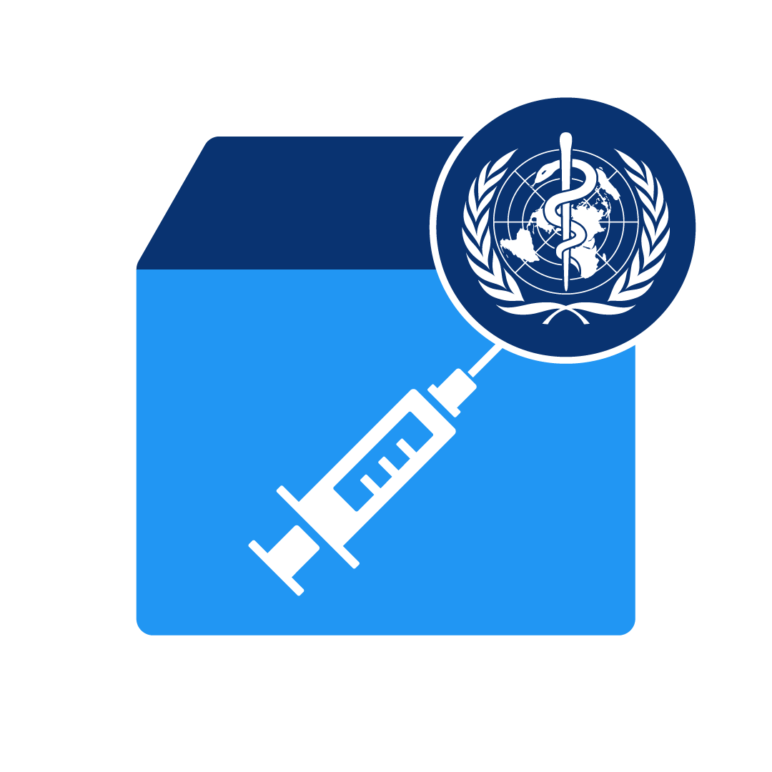
2021: COVID-19 vaccine delivery
14 of 15
In 2021, as the COVID-19 pandemic continued, the HISP network developed and deployed additional metadata packages and tools to support the global effort to manage COVID-19 vaccine delivery.
Prev
Next

Slide 15





Now: Continuing evolution
15 of 15
DHIS2’s features and capabilities are being expanded upon today, incorporating the latest web technologies to improve DHIS2’s performance and increase its functionality. At the same time, governments, NGOs and other organizations continue to deploy DHIS2 to address new challenges and in new domains.
Prev
Next

Slide 16
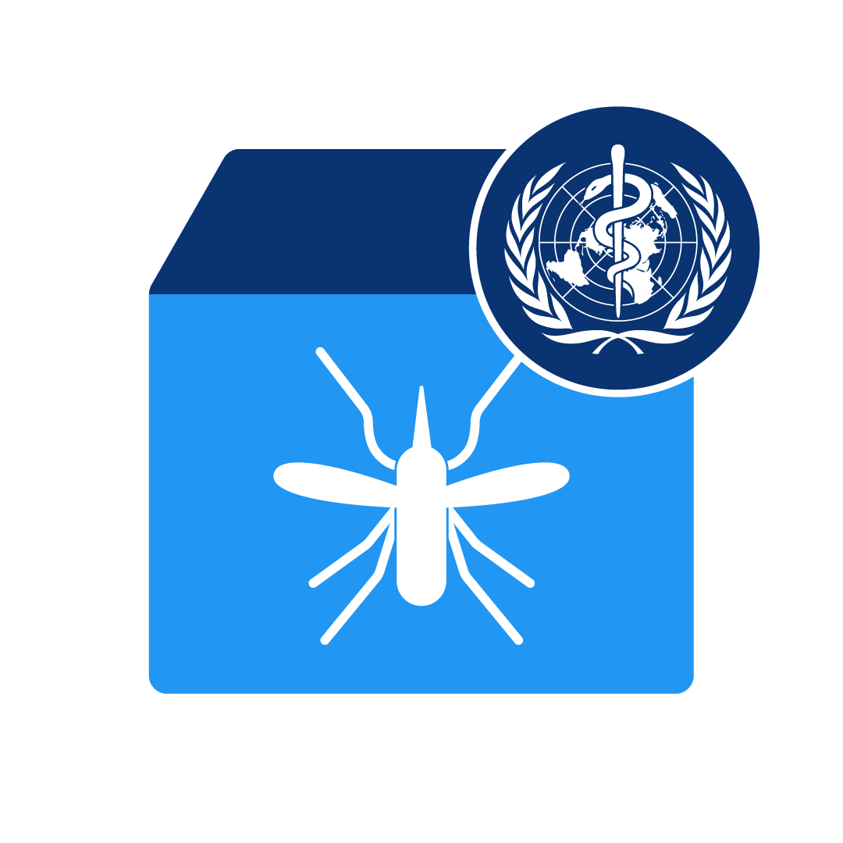

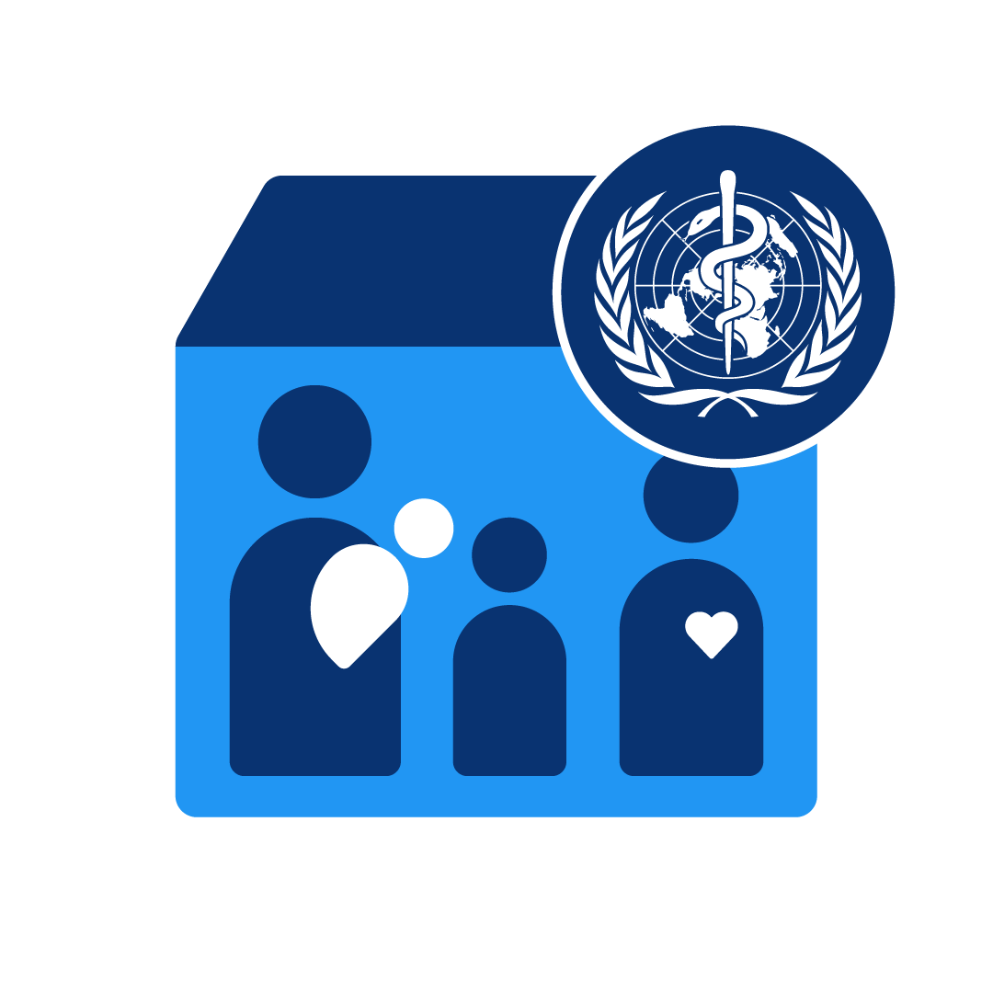
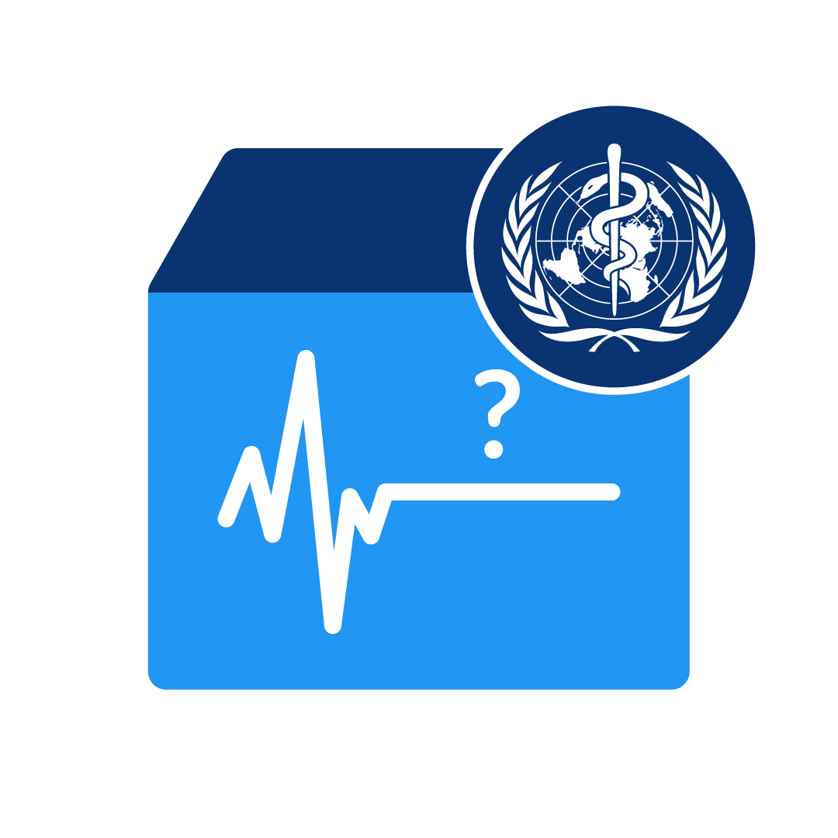
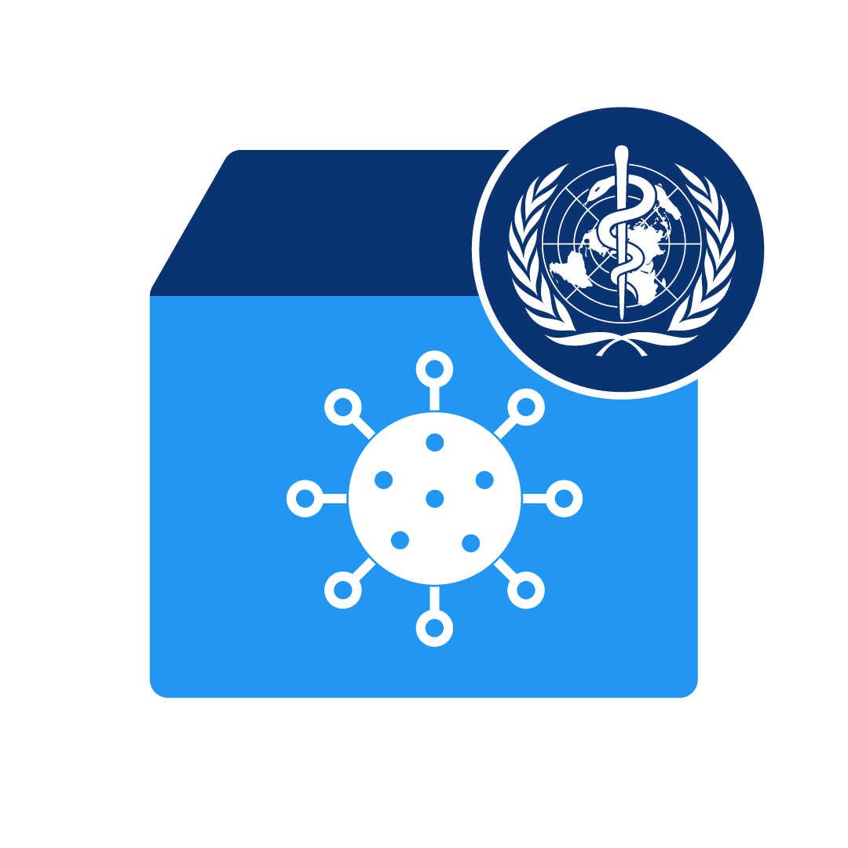
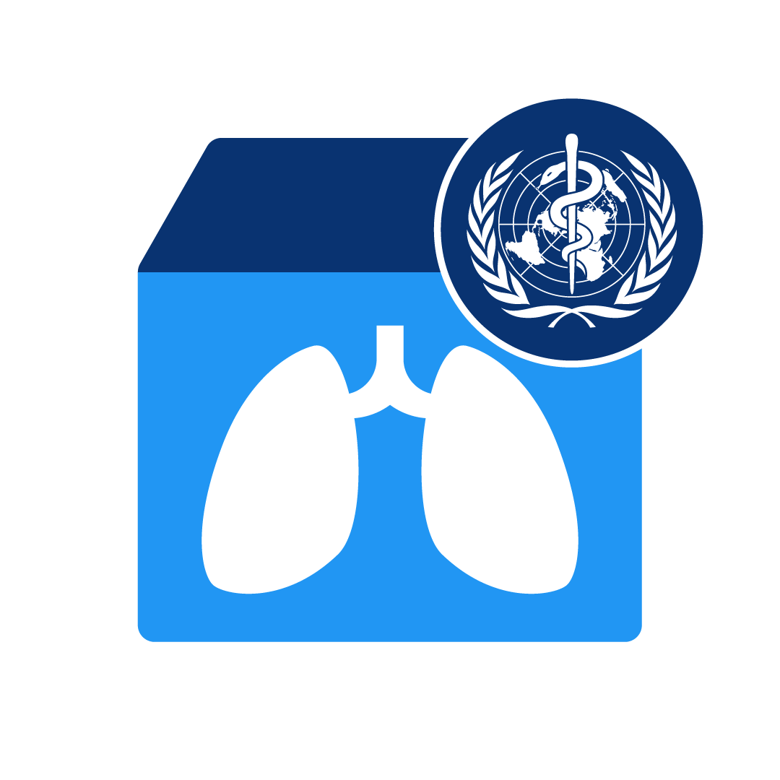
Now: Continuing evolution
15 of 15
DHIS2’s features and capabilities are being expanded upon today, incorporating the latest web technologies to improve DHIS2’s performance and increase its functionality. At the same time, governments, NGOs and other organizations continue to deploy DHIS2 to address new challenges and in new domains.
Prev
Next

